Slide 1
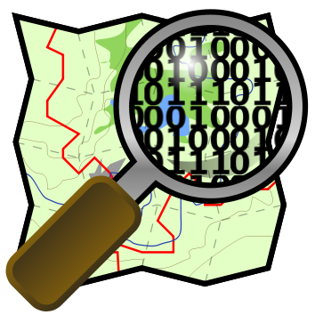
Open Street Map Diffusion

Slide 2
Dataset
Only GPS points (lat-lon coordinates)
~55GB
(about 3 billions couples)

Slide 3
Target
Visualize these data
reducing dimensions
and enrich with other datasets

Slide 4
Steps
Reduce dataset dimension and visualize it
Calculate the number of GPS hits in each country
Merge different datasets
Visualize the merged dataset

Slide 5
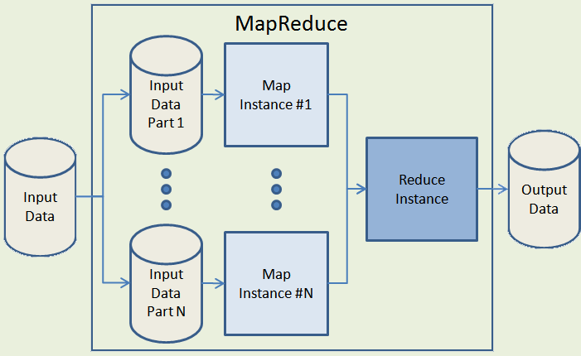
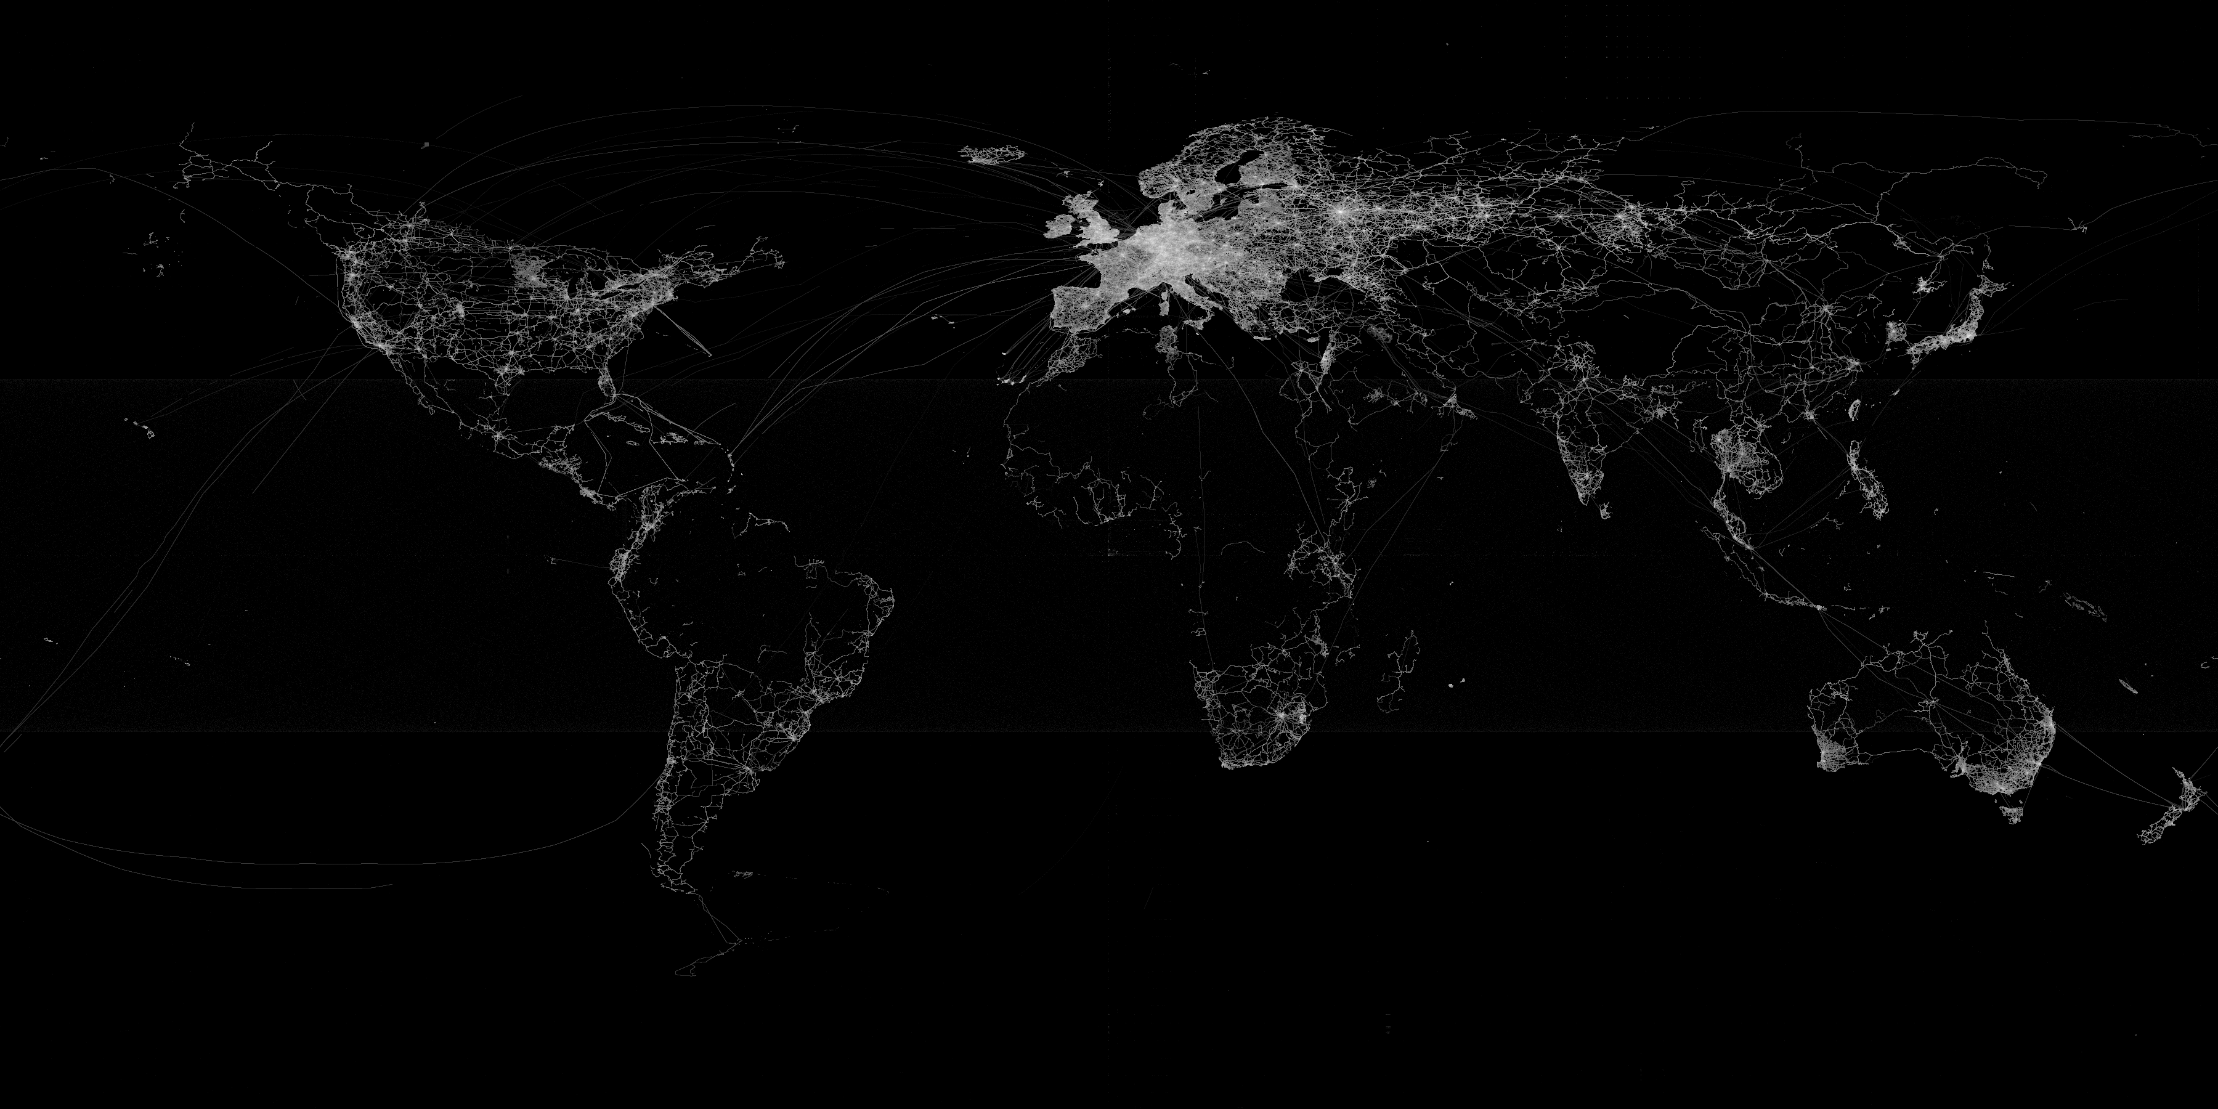
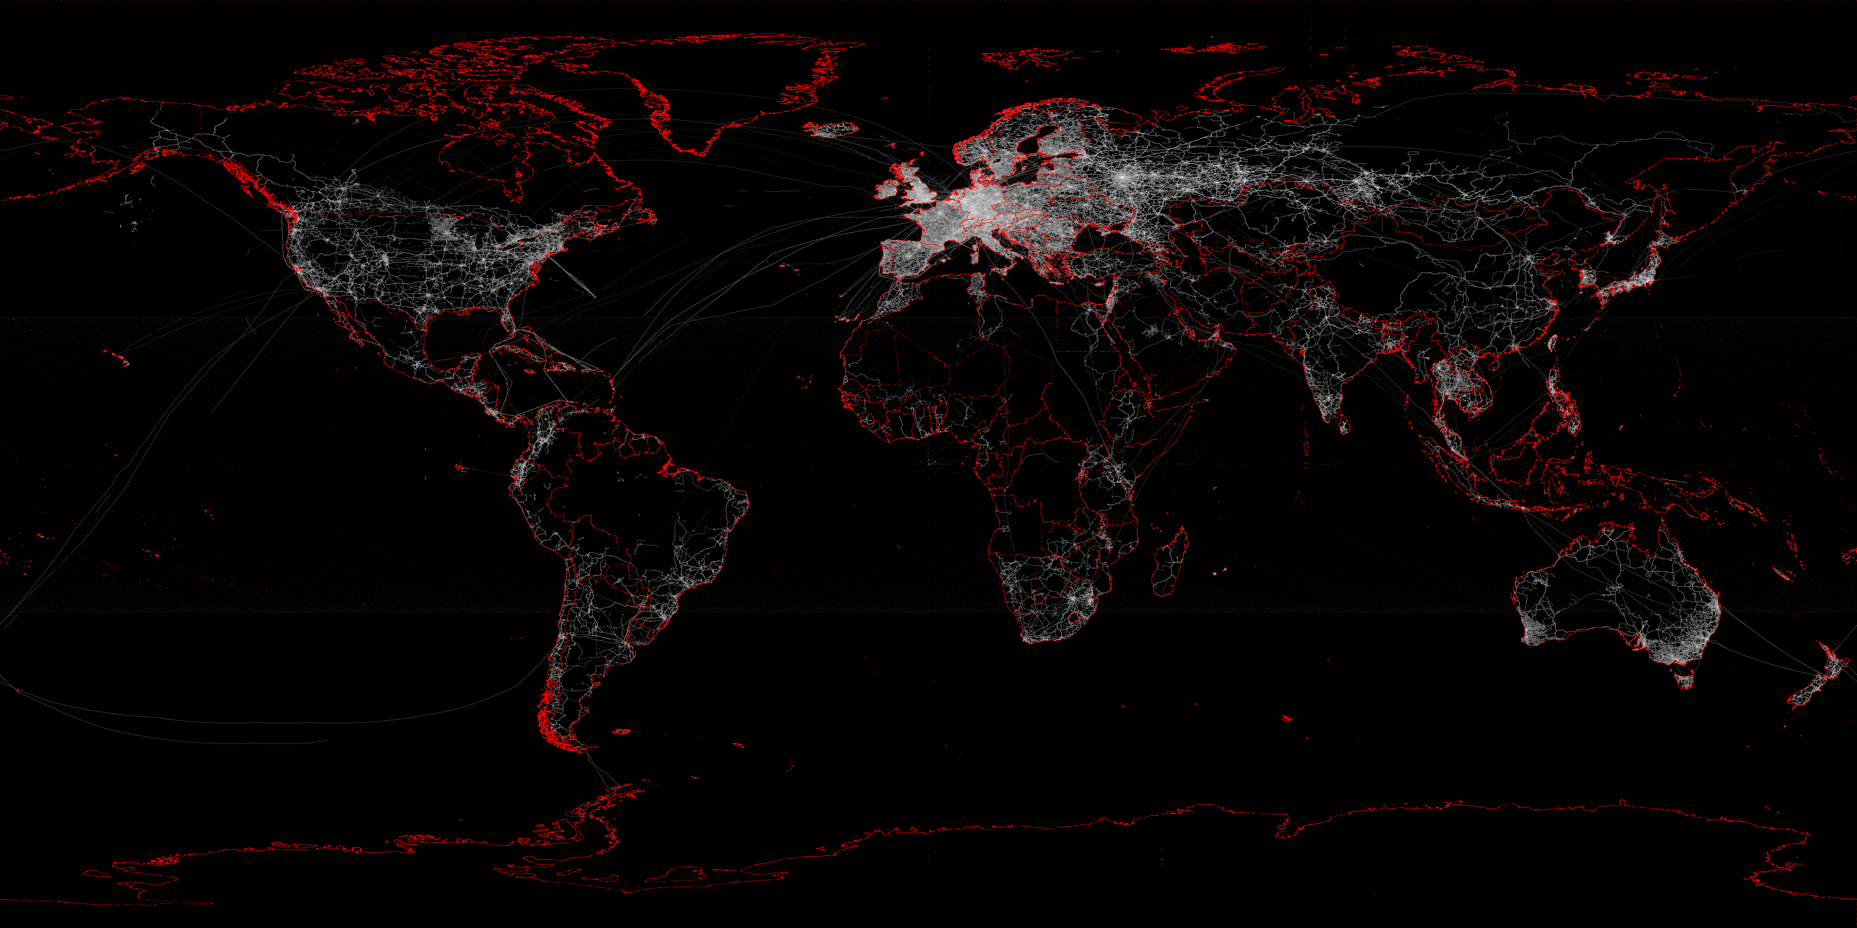
Map Reduce
From 3billions points to 7milions
(3600x1800 matrix)
Adding country boundaries with a shapefile?
Computable

Slide 6
Steps
Reduce dataset dimension and visualize it
Calculate the number of GPS hits in each country
Merge different datasets
Visualize the merged dataset

Slide 7


# of points per country
Problem: heavy algorithm
for each point, each country (
draw a direction and calculate how many boundaries it hits
if odd number it’s outside then continue
if even number it’s inside then break )
First Solution→ with std algorithm in python
100years
Second Solution→ optimized algorithm
25days

Slide 8



# of points per country
Parallelize tasks on multiple cores or speed up code
C Java
High performance
thread on multiple cores
With special thanks to Cython and Jython

Slide 9
Steps
Reduce dataset dimension and visualize it
Calculate the number of GPS hits in each country
Merge different datasets
Visualize the merged dataset

Slide 10
Other Info
We know how many points per country
but… how they contribute to OSM cause?
We add information:
Population
Area
Population density
Internet usage

Slide 11
Steps
Reduce dataset dimension and visualize it
Calculate the number of GPS hits in each country
Merge different datasets
Visualize the merged dataset

Slide 12
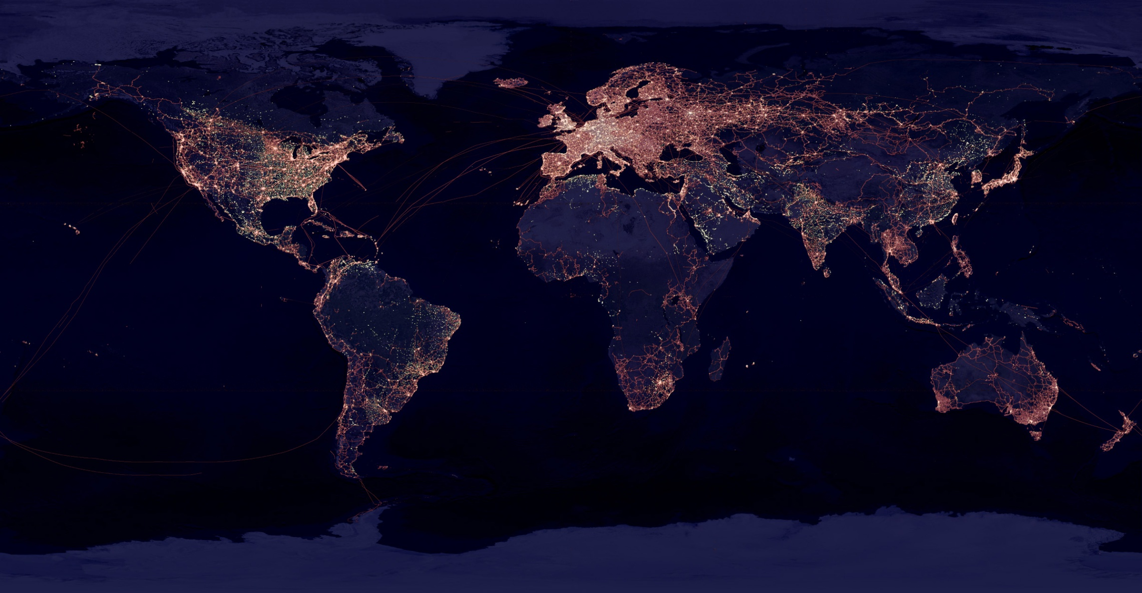
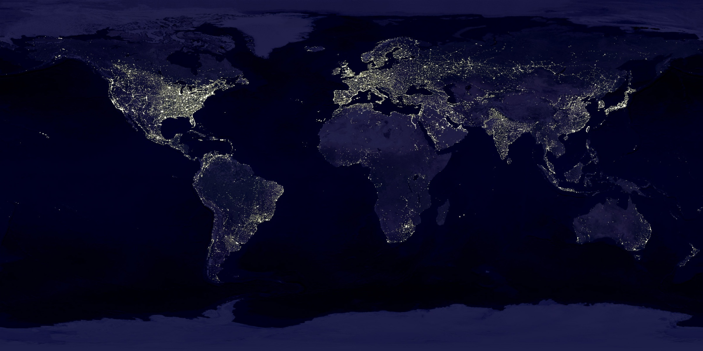
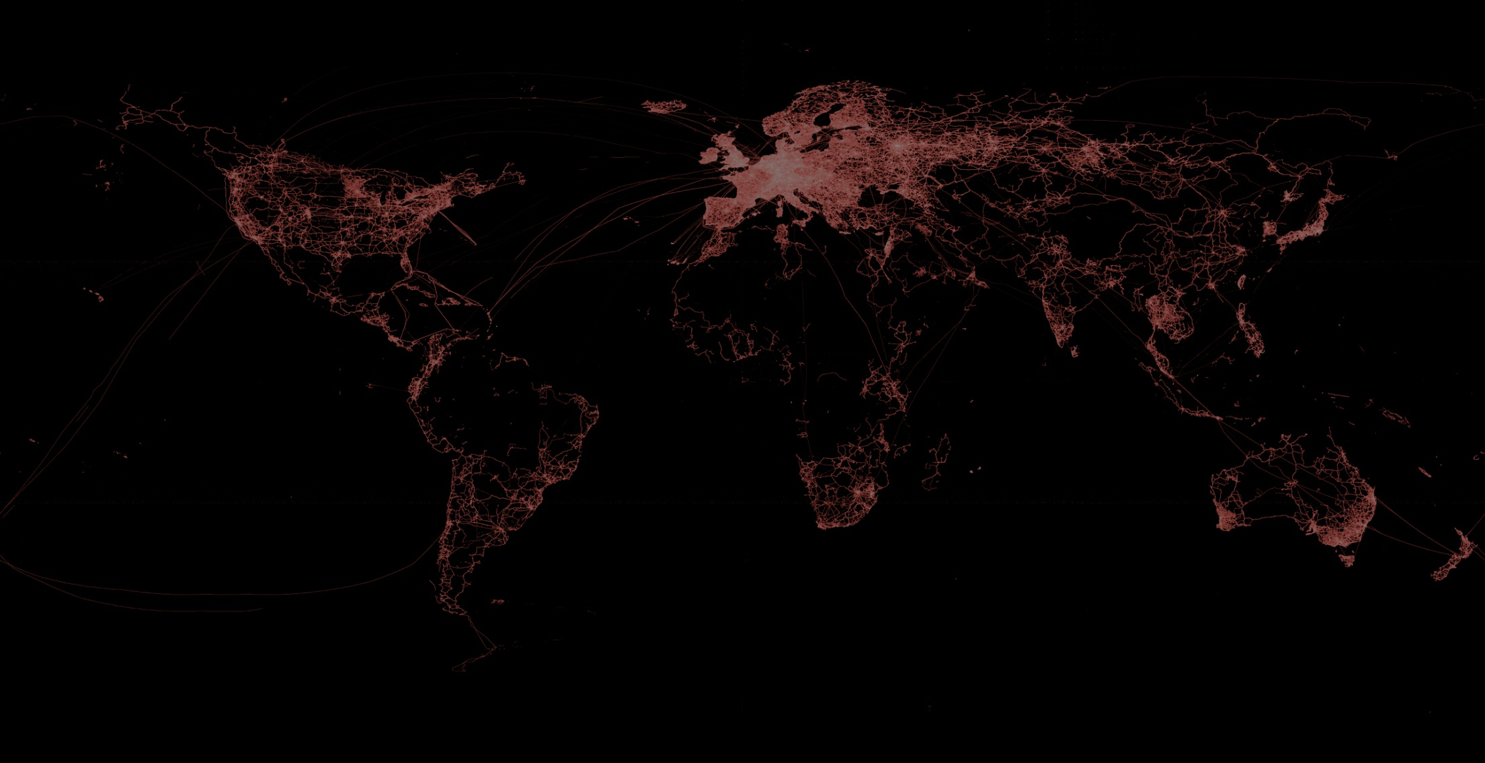
OSM Diffusion
Other way to corrrelate population to OSM contribution is to show a NASA night lights map and overlap it onto OSM hits map
_{Nasa night lights photo}
_{Open street map hits}
_{Overlap}

